Slide 1
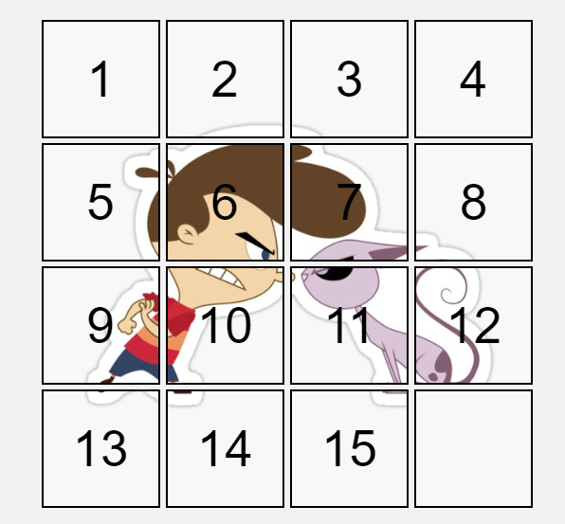
Fifteen Puzzle Game
Subhash Gumpena
Yaswanth Kurre

Slide 2

Motivation
Enhancing Problem-Solving Skills: The fifteen-puzzle game presents a classic problem-solving challenge that requires logical reasoning, algorithmic thinking, and efficient code implementation.
Exploring Game Development Concepts: Creating a fifteen-puzzle game introduces developers to basic game development concepts such as user interface design, event handling, and game loop management.
Learning JavaScript Fundamentals: Developing a fifteen-puzzle game provides an excellent opportunity to practice and apply fundamental JavaScript concepts
Demonstrating Programming Proficiency: Completing a fifteen-puzzle game using JavaScript showcases a developer's ability to apply programming concepts to a practical application.

Slide 3
Project Flow
Select Background
User
Generate Puzzle
Shuffle Puzzle
Select Puzzle Size

Slide 4
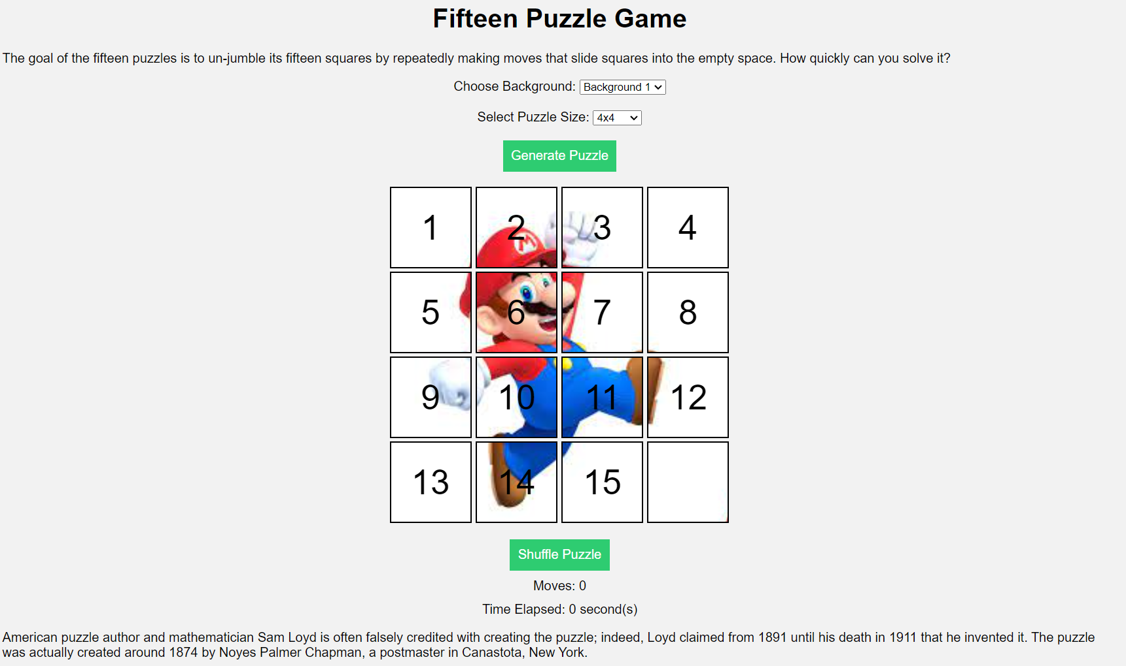
Fifteen Puzzle Game Page
Option to select a background image of your choice.
Option to select a puzzle choice based on size.
Generate Puzzle will generate a game based on your choices.
Once you are well versed with the puzzle, you can click on shuffle puzzle to start the game. You time and moves will be monitored

Slide 5
Key JS Concepts Used
DOM Manipulation:
Definition: DOM, or Document Object Model, manipulation is a fundamental JavaScript concept that involves interacting with the HTML document's structure.
Usage in the Project: In the fifteen-puzzle game, DOM manipulation is employed to dynamically update and modify elements on the webpage. This includes altering the appearance of the puzzle tiles, updating scores, and handling user interactions.
Events:
Definition: Events are actions or occurrences that happen in the browser, such as user clicks, key presses, or page load.
Usage in the Project: Events are crucial in the game for capturing user interactions. For instance, the 'click' event is utilized to detect when a puzzle tile is clicked, triggering the necessary actions to rearrange the puzzle or update the game state.

Slide 6
Key JS Concepts Used
Functions:
Definition: Functions in JavaScript are blocks of reusable code designed to perform a specific task.
Usage in the Project: Functions play a pivotal role in structuring the code and making it modular. Functions are created to encapsulate different aspects of the game logic, such as shuffling the puzzle tiles, checking for a winning state, and updating the score. This promotes code reusability and maintainability.
Asynchronous JavaScript:
Definition: Asynchronous JavaScript enables non-blocking code execution, allowing certain tasks to be performed independently of the main program flow.
Usage in the Project: Asynchronous concepts may be applied in scenarios such as fetching external resources or handling user input without freezing the game's interface. Promises or async/await syntax may be employed for managing asynchronous operations.

Slide 7
User Interface Design
Layout:
The overall layout is simple and straightforward, with the puzzle container taking center stage. The shuffle and generate buttons are placed above the puzzle container, and the success message, moves counter, and timer are positioned below it. This arrangement ensures that the puzzle is the primary focus of the user's attention.
Styling Choices:
The provided CSS code defines a clean and modern style for the UI. The use of a sans-serif font and subtle border-rounding creates a sleek and minimalistic look. The puzzle pieces are highlighted with a red border and underlined text when they are movable, providing clear visual feedback to the user. The success message is displayed in green, adding a touch of color and emphasizing the achievement of solving the puzzle.
.number-swap-animation: Applies the number-swap animation to the piece when it's moved.
@keyframes number-swap: Defines the number-swap animation, which fades the piece's opacity to create a visual transition.
.puzzle-piece: Defines the individual puzzle pieces.
#shuffle-button,#generate-button: Styles the shuffle and generate buttons with a consistent appearance, including font size, padding, background color, text color, and border.

Slide 8
Shuffling Algorithm Explanation
The code implements an insertion sort shuffling procedure by looping backwards through the array of puzzle piece elements and randomly swapping indices.
Application of Math.random() and Math.floor() to generate random indices
Double loop processes entire array to create randomness
Outer loop steps backward through piece indices
Inner loop generates random integer up to current index
Compares true order array to existing shuffled array
Map textContent values to a simple integer array
Calculate number of inversions:
Inversions occur when a larger value appears before a smaller value
Nested loop compares adjacency pairs
After shuffling, verify the parity of inversions
Count inversions and analyze position of blank space (emptyRowIndex)
If board not solvable based on parity rules, swap final two pieces
Ensures initial shuffle results in winnable game state

Slide 9
Parity Solvability Logic
The puzzle is solvable if the parity of the number of inversions matches the position of the blank tile based on rules for even and odd sized puzzle grids.
Count number of inversions in shuffled board array
Inversions mean a smaller number appears after larger
Don't count blank space as causing inversions
Need to analyze inversions count vs position of the empty space tile
Even grids have alternating odd/even rows & columns
Blank tile on odd row => even inversions is solvable
Blank tile on even row => odd inversions solvable
For odd grids, always solvable if even inversions after shuffle
If parity mismatch, swap last two tiles to make solvable
Ensures initial shuffle can lead to proper solution

Slide 10
Tile Movement Algorithm
The tile click handling uses the index positions of the clicked tile and blank space to determine adjacency and properly shift positions.
Get index of clicked puzzle piece in pieces array
Find index of "empty" space piece
Check row/column math to verify adjacency
If difference between indices is 1:
Toggle CSS classes for animations
Swap the textContent values
Store initial transform properties
Set transitions and new transform values
Reset styles after animation durations
Increment counter tracking number of moves
After moving, check if pieces array is properly sorted
Iterates through pieces to match indices + 1

Slide 11
Extra Features
End-of-Game Notification
Displays message with move count and time statistics
Provides restart game link to play again
Animations and Transitions
Animates tile shuffling randomly
Smoothly transitions tile moves
Game Timer and Music
Tracks time elapsed while playing
Background music plays during game
Multiple Backgrounds
Selectable background image options
Updates all tile background styling
Different Puzzle Sizes
Select puzzle dimensions from 3x3 up to 10x10
Dynamically resizes overall puzzle grid
Here are the key points for some of the extra features we did:

Slide 12
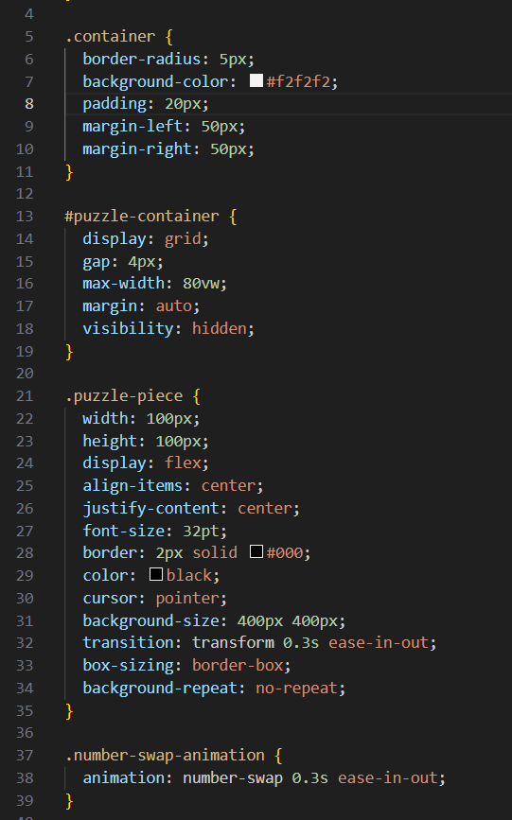
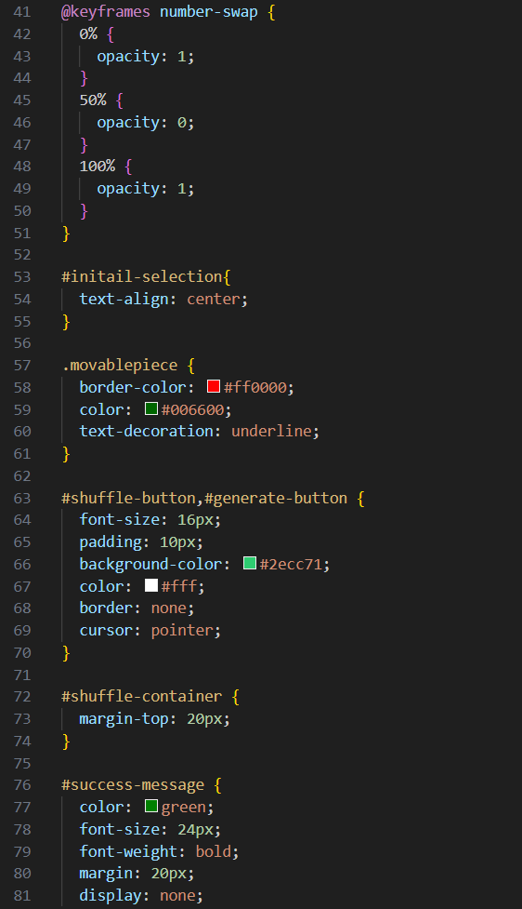
Sample CSS Code Snippets

Slide 13
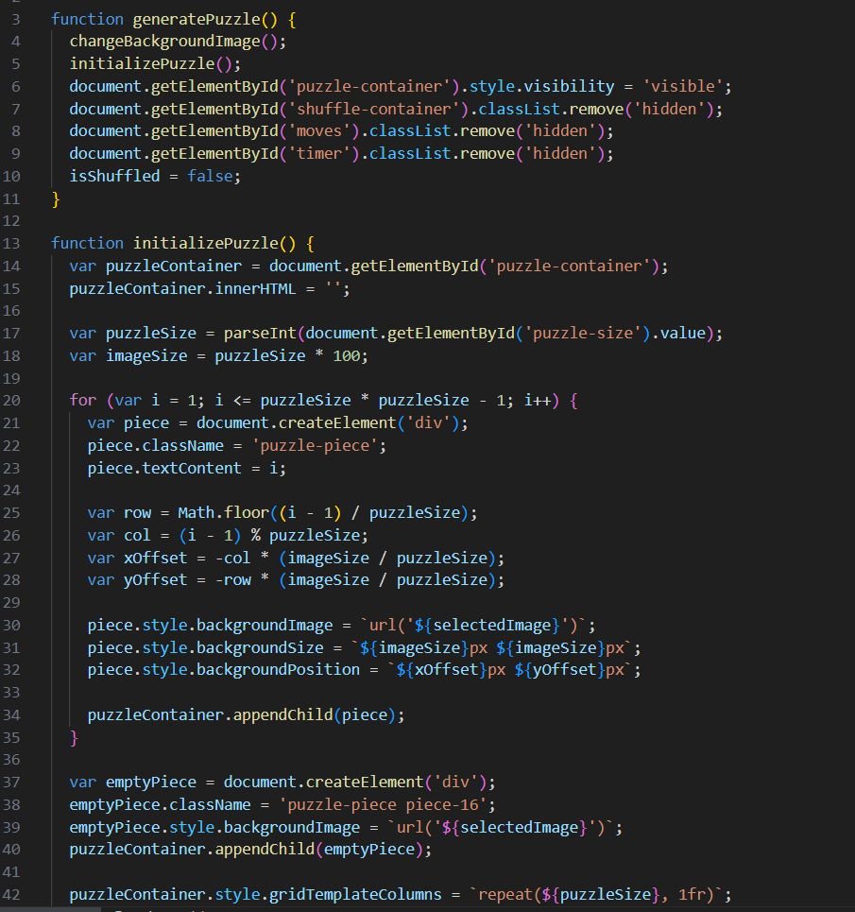
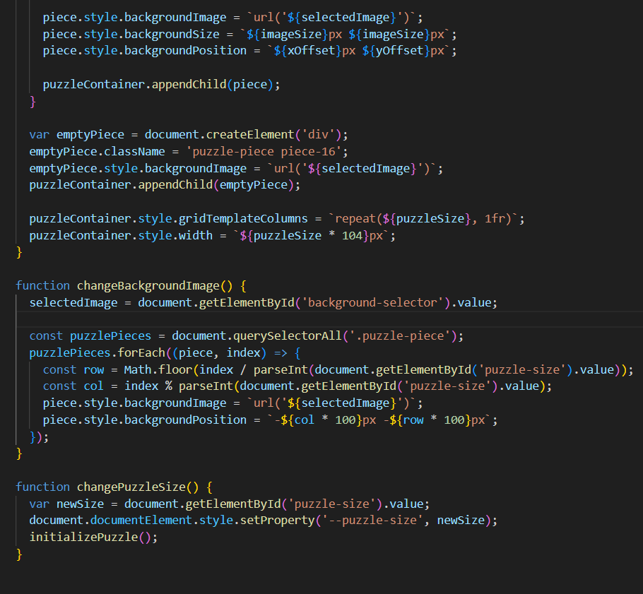
Sample JS Code Snippets

Slide 14
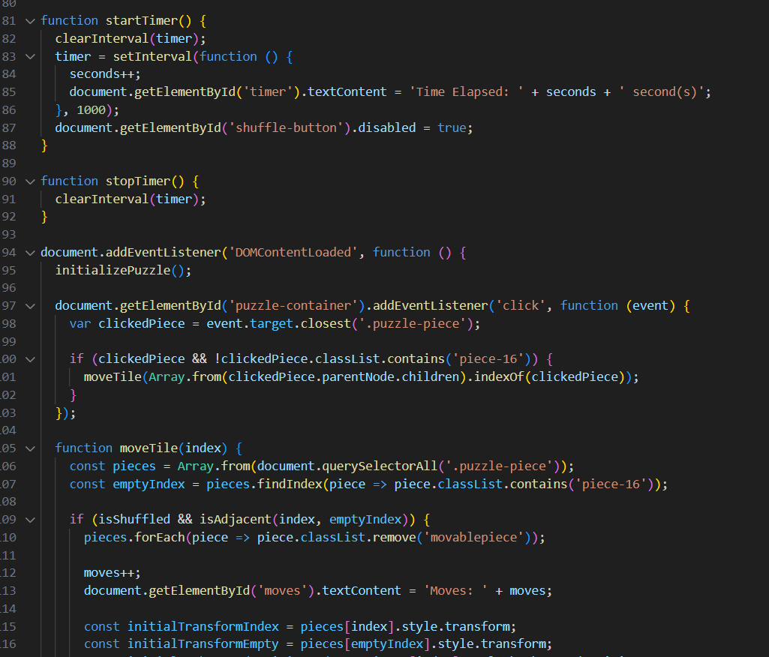
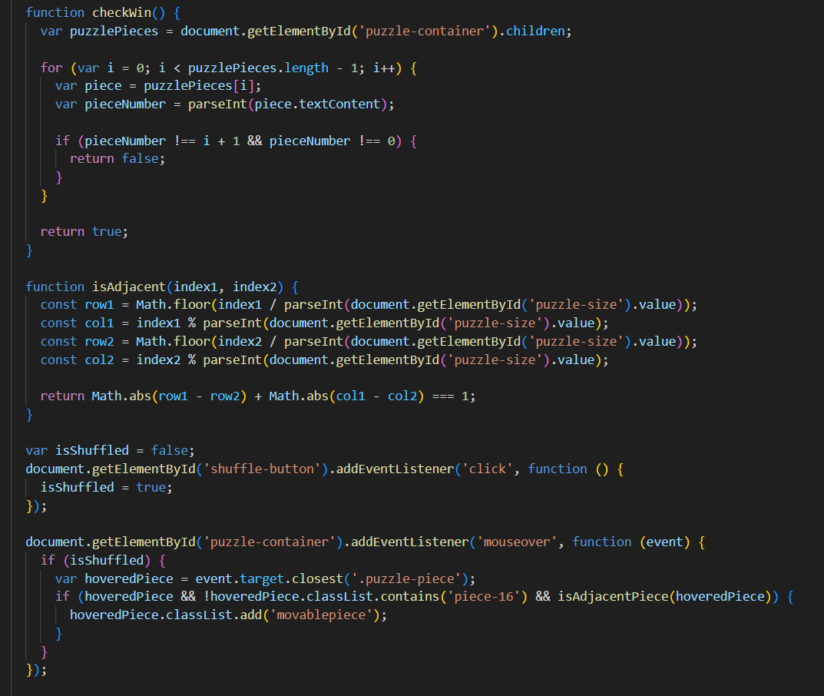
Sample JS Code Snippets

Slide 15
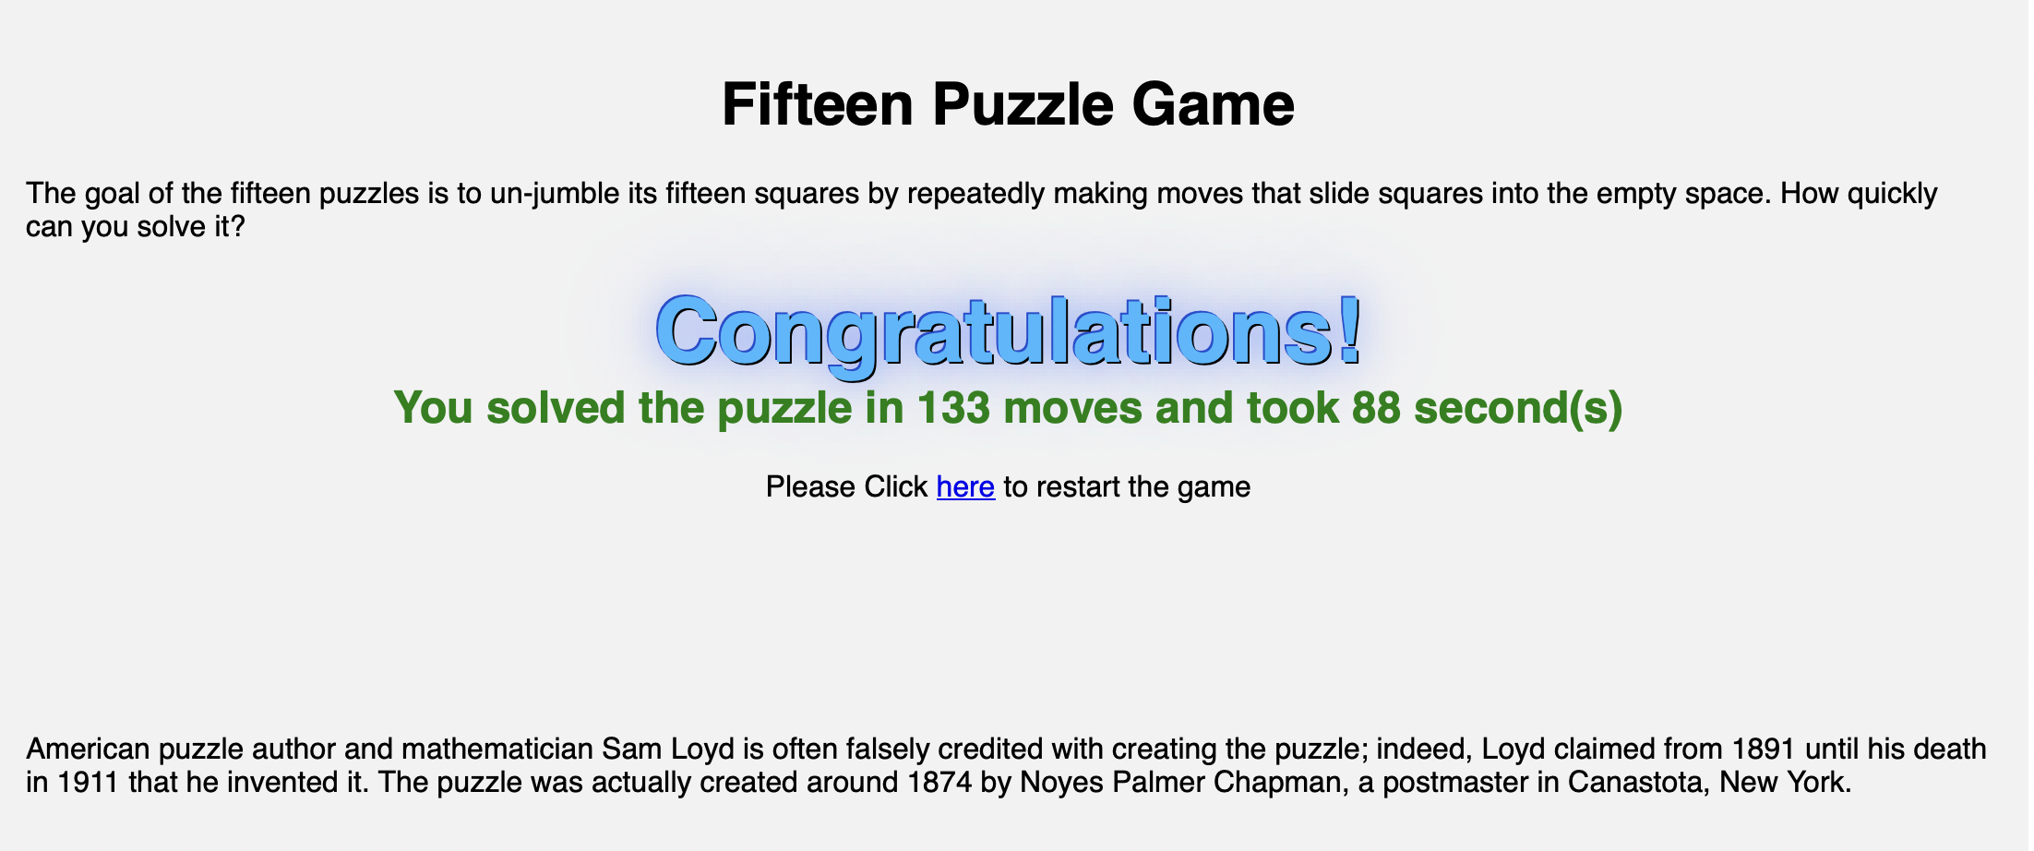
Final Output

Slide 16

Thank you

